Slide 1
Car_Dekho_Data Prediction Using Machine Learning Model.
Presented By:
Md Shayan Shafique

Slide 2
OBJECTIVE
Develop a predictive model to accurately estimate the selling price of used cars based on relevant features.
Analyze the impact of different variables on the resale value of used cars.

Slide 3
DATA DESCRIPTION
Target Variable:
Selling Price
Predictor Variables:
Car Name
Year
Kms Driven
Fuel Type
Seller Type
Transmission
Owner
Day Mins
Day Calls
Monthly Charge
Overage Fee
Roam Mins

Slide 4
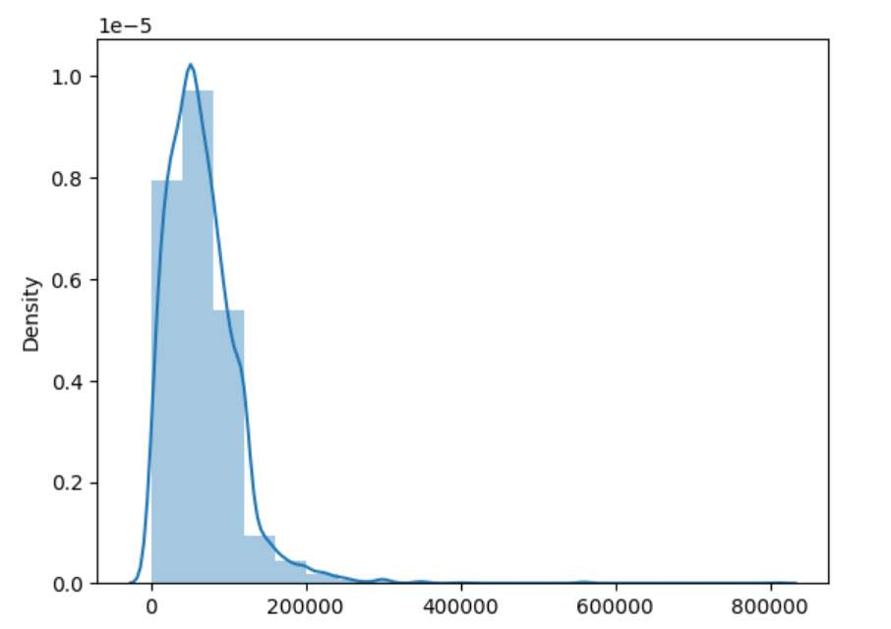
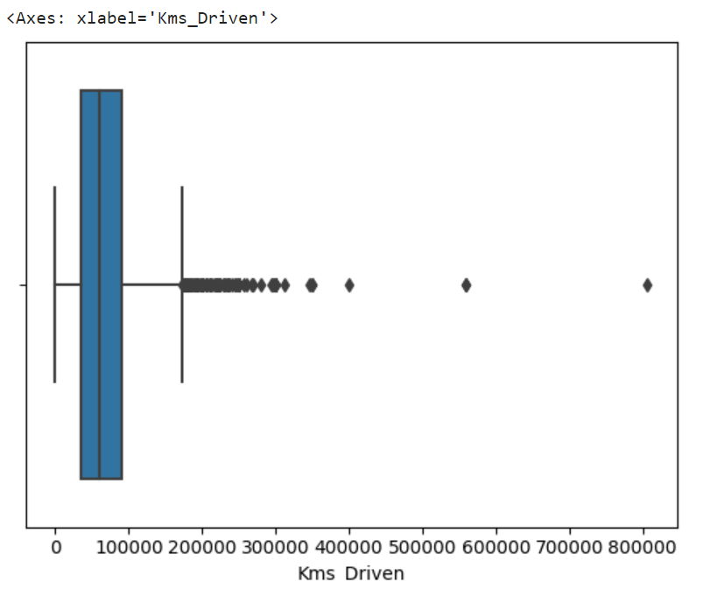
EXPLORATORY DATA ANALYSIS
Distribution and Box Plot for Kms Driven

Slide 5
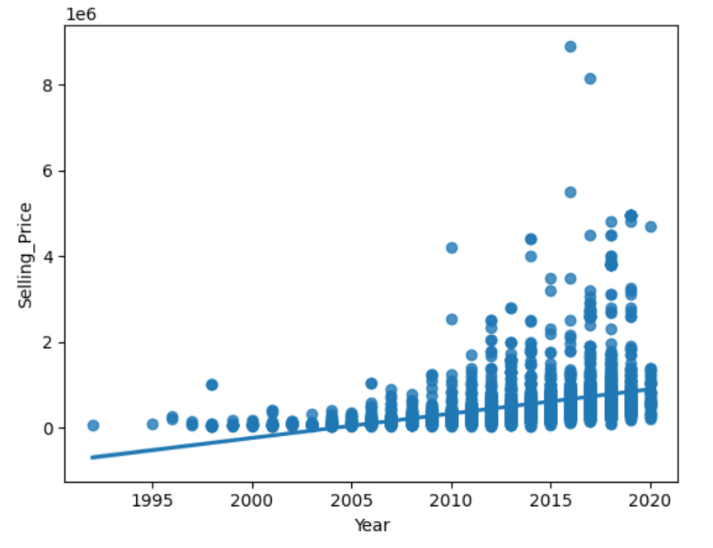
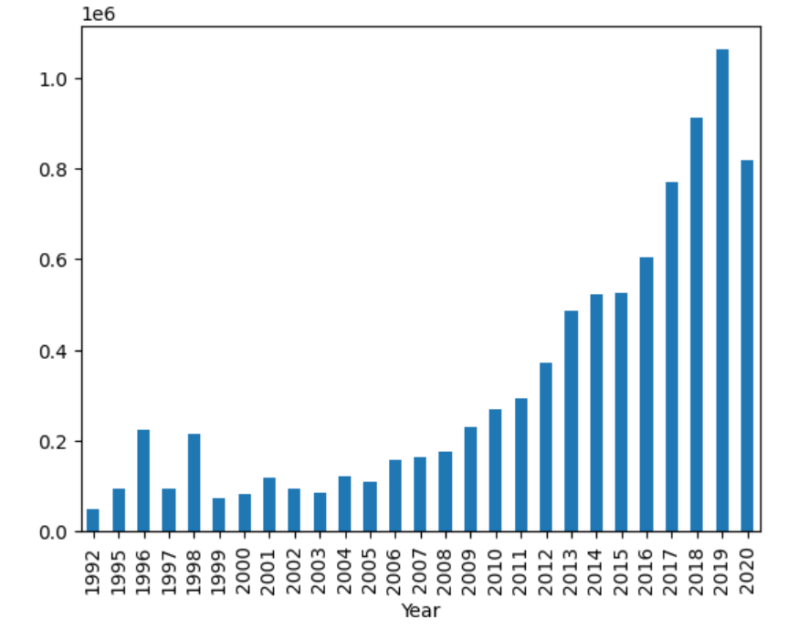
EXPLORATORY DATA ANALYSIS
Bivariate Analysis for Selling Price and Year

Slide 6
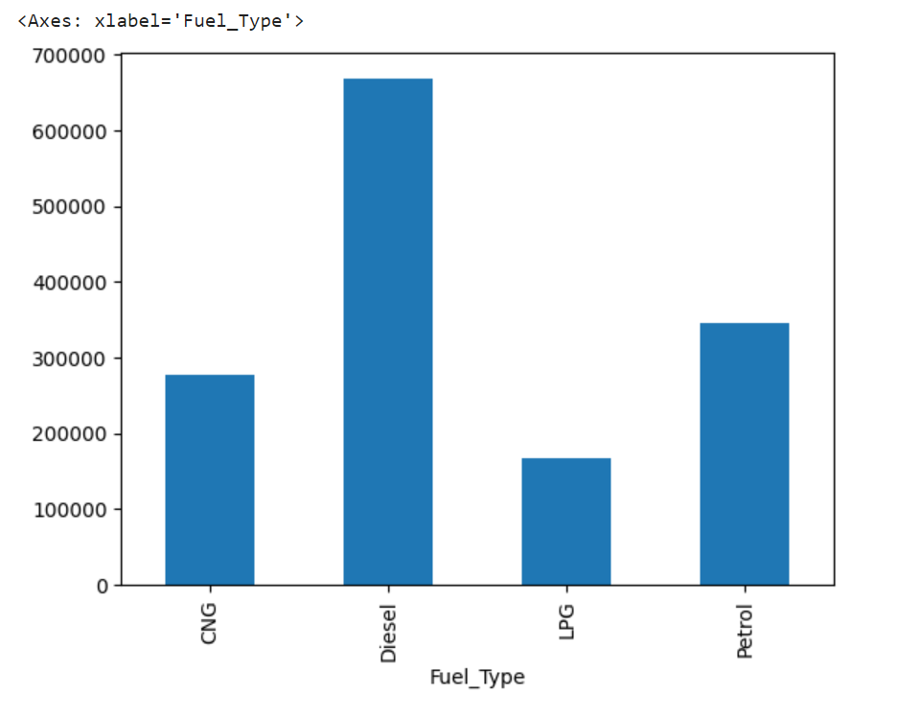
EXPLORATORY DATA ANALYSIS
Diesel Cars has highest selling price
LPG Cars has lowest selling price

Slide 7
FEATURE ENGINEERING
Feature Selection
Encoding Categorical Variables.
Vectorising
Scaling

Slide 8
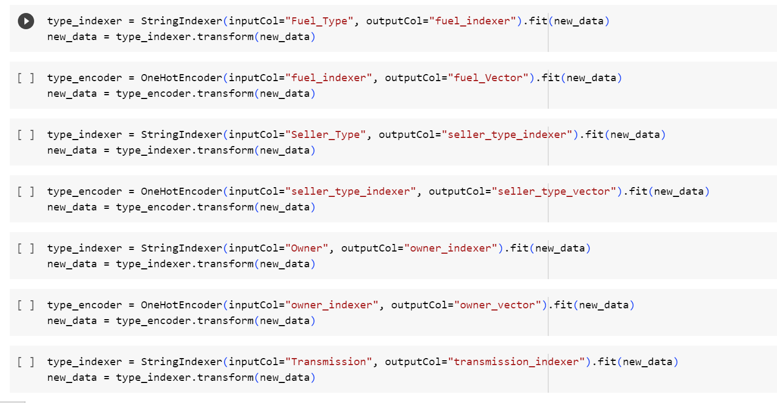
FEATURE ENGINEERING
Scaling of features has been done here after encoding and assembling.

Slide 9
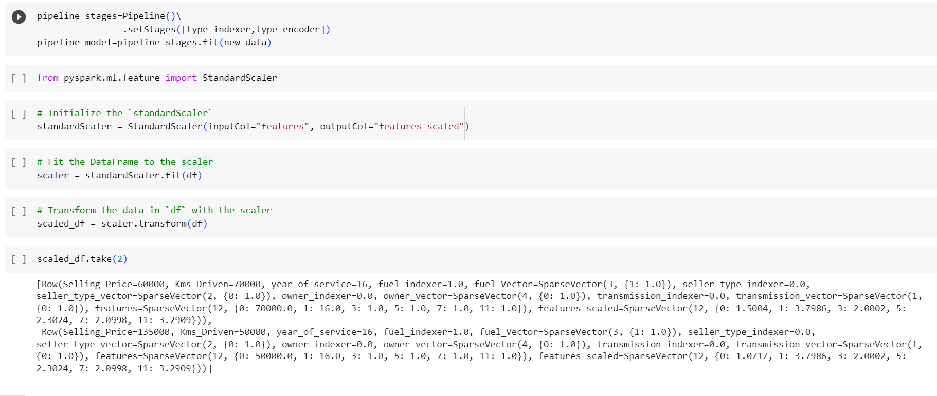
Estimators in a Pipeline

Slide 10
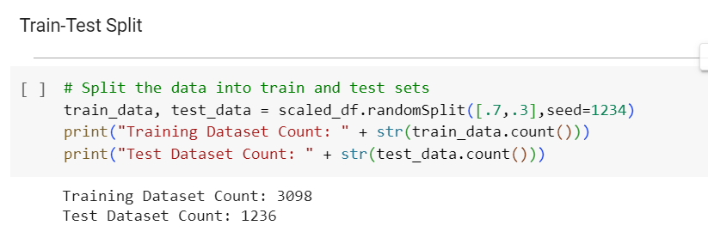
Train – Test Split

Slide 11
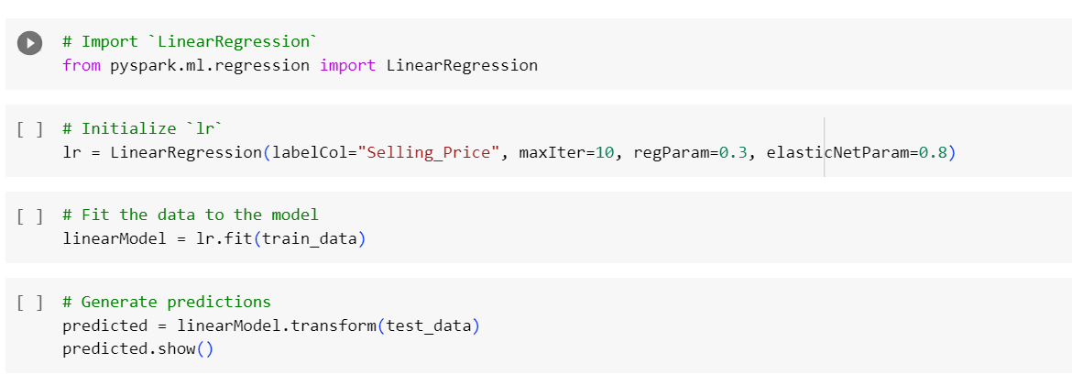
MODELLING
Linear Regression

Slide 12
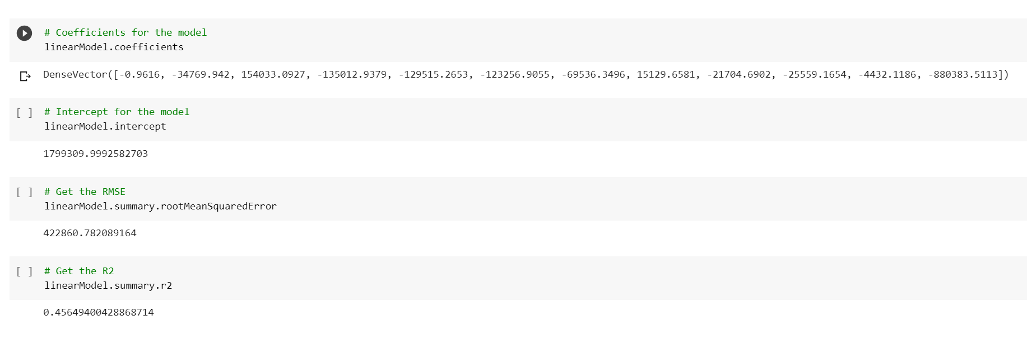
MODEL RESULT

Slide 13
CONCLUSION
The intercept value is 1799309.99 , indicating the estimated base price for used cars.
The RMSE of 422860.78, suggests that the model ‘s predictions have an average deviation of approximately 422860.78 of the selling prices.
The R2 of 0.45 indicates that the model explains 45% of the variance in the selling price.

